Slide 1
Building An Inner-City Swim Program
Chris Van Slooten
slooten2@yahoo.com

Slide 3
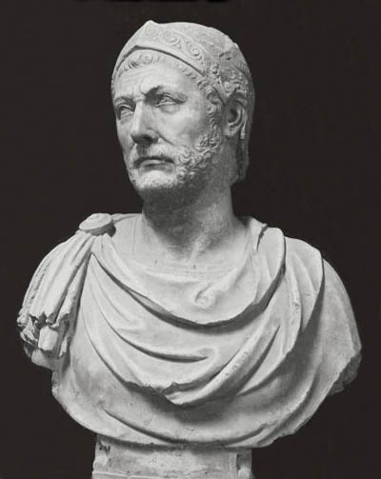

Slide 4
Can You Identify?
Always worked from a deficit.
Short on supplies
Short on soldiers
Short on money
Nearly everything against him.
81% Hispanic
9% African American
9% Caucasian
1% Other
62% Economically Disadvantaged
32% Mobility
Holmes Swimming & Diving
7% Club swimmers
33% High school experience
60% New to swimming
Hannibal of Carthage
Holmes High School

Slide 5
Will Anybody Do?
Who Do You Look For?
Quantity
Quality
Notes:
Application
Interview
Physical Test
Character

Slide 6
Anatomy of a Successful Teams Article: Winning Teams Speaker/Author: Bill Sweetenham and Charlotte Parker Publication: American Swimming; Volume 9, Issue 5
20%
40%
40%

Slide 7
The Husky Way
Unity
Unity within our athletic teams is an essential ingredient for success according to The Husky Way. Though you may not be close friends with everyone on your team out of the pool, teammates must be “best friends” in the pool. Encouragement is vital to team strength, while criticism stemming from petty jealousy will always weaken the team effort. Every member of the team is important. A team will only be as strong as its weakest link. Include teammates, don’t exclude them. Be happy when someone else on the team is honored, knowing that their praise brings honor to all!
Academics
The Husky Way stresses the importance of schoolwork in each student-athlete’s life. In fact, doing well in school is what allows you to participate on the team. You will not participate if you do not stay on top of your academic responsibilities. Keeping priorities straight is The Husky Way.
Sportsmanship
The Husky Way is characterized by sportsmanship. Good sportsmanship is a positive reflection on your school, your team, and yourself. We always shake hands with opponents after each meet/game, being gracious in victory or defeat. We hold our heads up and look the other team in the eye as we congratulate them on their effort. We avoid making excuses, blaming officials, or criticizing playing conditions. We acknowledge the other team’s strengths, and we do not “bad mouth” anyone. We never feel ashamed when we lose if we played our best.
Travel
The Husky Way is the way of responsibility. We always leave a place “nicer than we found it.” Whether at restaurants or at opponents’ fields, gyms, or locker rooms, we do not leave trash for others to pick up. If we are unsure about whose trash it is, we take responsibility and throw it away! Behaving properly on the athletic bus and at the facilities of our opponents is another aspect of The Husky Way. We do not yell from the bus or make inappropriate remarks. We always use “sir,” “ma’am,” “please,” and “thank you” when speaking with an opposing coach, teacher, or referee.
Conclusion
The Husky Way demands your very best, both in the pool and in the classroom. It demands your best in your relationships with your teachers, coaches, parents, and teammates. Indeed, it demands your best in all areas, but when you do your best, you will have no regrets. This is The Husky Way.
I, _____________________________, have read and understand the Husky Way. By signing my name I agree to uphold what it means to be a member of the Husky Swimming and Diving Team.
Signature __________________________________
Date __________________
“THE HUSKY WAY”
Honor. Integrity. Discipline. Excellence
Introduction
“The Husky Way” is a rewarding and proven path to excellence in athletics. The Husky Way is not easy- there are easier roads to take. Those who embark on The Husky Way realize that anything worthwhile costs something. As you read about The Husky Way, I hope you will be challenged and encouraged to make this year in swimming and water polo your best one yet.
Focus
The Husky Way has a simple and clear focus: Honor. Integrity. Discipline. Excellence. We want to conduct ourselves honorably and with integrity while being disciplined in our thoughts in our words, our actions, our thoughts, and our motives, particularly as we participate as a member of the Husky Swim & Dive Team which will produce excellence in all we do.
Winning and Losing
The Husky Way says that if you have done your best, you are a winner regardless of the scoreboard. By all means we strive to win, but winning is secondary to our ultimate goal of giving 100% of ourselves to the team effort. The theme of our swim and water polo program is 99% correct is 100% wrong.
Competition
One of our main goals is to practice hard in order to beat our opponents, and during meets/games we do everything within the bounds of fair competition to achieve victory. Yet it is competition coupled with the right attitude that represents The Husky Way.
Attitude and Hard Work
The Husky Way is all about attitude. A good attitude is the overriding feature of success in the Husky Swimming and Water Polo programs. First, our teams should never be out-hustled! Hustle is a never-give-up, never-say-die approach. Secondly, our teammates should have the attitude of being coachable, willing to listen, and eager to improve. The Husky Way finds no substitute for hard work. There is a saying reminding us that “the only place you will find success before work is in the dictionary.” The three D’s apply here: desire, dedication, and determination. Mental and physical toughness come from hours and hours of hard work. Our athletes should work harder than any team around.

Slide 8
Why Do You Do What You Do?
Tradition?
Expectations?
Pressure?
Fear?
Pride?
Creative thinker
Notes:
No “Handouts”
Community Service
Husky Way

Slide 9
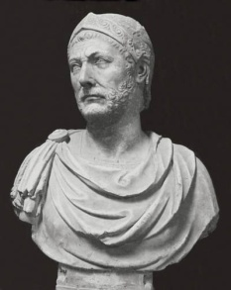
Leadership
Never asked more from soldiers than he was willing to give.
Manage details
Disciplined approach
Develop mentor leaders
Create Identity (H.I.D.E)
High standards
Hannibal
Holmes

Slide 10
Hannibal of Carthage
“What do you think the Alps are? They are nothing more than high mountains. Their heights are not insurmountable to men of determination. We came to conquer Rome, now steel your hearts and climb.”

Slide 11
Big Ideas
Look for ways for your program to be different.
Maintain/Establish high standards
Create an identity

Slide 12
Husky Swimming Program Progression
Inexperienced
Years 1-2: Technique
Years 3-4: How to Train
Experienced
Years 1-2: How to Train
Years 3-4: How to Compete

Slide 15
What Is Your Anchor?

Slide 16
Community Involvement

Slide 17
Mentor

